Slide 1
Week 12: The European Union
Thursday 14th April
Mr. Niall Douglas

Slide 2
Schedule for Today
9am-9.15am: Quick overview of exam results
9.15am-10.45am: Niall’s History of the History of the Irish Revolution part 3 of 3
10.45am-11am: Niall’s contact details
11.20am-12.20pm: Group presentations
FIN (super sad panda!)

Slide 3
Average performance

Slide 4
Max performance

Slide 5
Min performance

Slide 6
The Irish Revolution
Yesterday we saw how Michael Collins had pioneered the use of asymmetric warfare to beat the British Empire
  He used information to fight the Empire without fighting them
    He used finance to raise a whole load of money
    He then used that money to bribe people for information
    He then used that information to make Ireland ungovernable by assassinating anyone helping the British

Slide 7
The Irish Revolution
This had sucked up:
  57,000 British soldiers
  14,200 Special Police
  2,600 Black and Tans
And with no income:
  No functioning tax collection
  No functioning legal system
  No functioning police system

Slide 8
The Irish Revolution
Britain was broke after the first World War, so money was very, very tight and the Irish war was expensive
Despite this, the British Cabinet (the Ministers who run the country) were determined to win through force
But Field Marshall Smuts had a plan ...

Slide 9
The Irish Revolution
In his weekly chats with King George, both men had become rather upset with the atrocities going on in Ireland
In past times Kings and Queens had felt such things necessary because they threatened the English state e.g. The Jacobites were French and Catholic inspired and sought to overthrow the British monarchy
This time round these revolutionaries were very different ...

Slide 10
The Irish Revolutionaries
After the potato famine, these revolutionaries were very different to before:
  They strongly believed in ownership of private property (before the famine they believed in feudalism)
  They strongly believed in capitalism
  They strongly believed in religious tolerance (before they wished a Catholic only Ireland)
  They strongly believed in democracy (before they wished to restore an Irish monarchy)
In other words, these revolutionaries looked more like British than Irish

Slide 11
The Irish Revolution
Winston Churchill later said:
  “What was the alternative? It was to plunge one small corner of the empire into an iron repression, which could not be carried out without an admixture of murder and counter-murder.... Only national self-preservation could have excused such a policy, and no reasonable man could allege that self-preservation was involved”
Note the reference to “self-preservation”

Slide 12
The Irish Revolution
So really the British couldn’t see them as a threat like they had in the past. These revolutionaries would play the same “ball game” as the British
So in June 1921 Smuts wrote up a peace treaty for the Irish, and gave it to King George and the Prime Minister Lloyd George

Slide 13
The Irish Revolution
Lloyd George, the King and Smuts then turned up at Cabinet. With the weight of the King, the Prime Minister, and one of the most highly respected men of that day, the Cabinet agreed to seek peace under the terms of Smuts’ peace treaty and to permit the King to start the ball rolling
The King gave a speech on the 22nd June 1921 in Belfast calling on:
  "all Irishmen to pause, to stretch out the hand of forbearance and conciliation, to forgive and to forget, and to join in making for the land they love a new era of peace, contentment, and good will.”

Slide 14
The Irish Revolution
On the 24th June the British Prime Minister wrote to Eamon De Valera asking for a peace conference to which De Valera agreed
A ceasefire came into effect on the 11th July
De Valera realised early on that full independence was impossible, so he realised he needed to avoid receiving the blame ...

Slide 15
The Peace Negotiations
So he refuses to attend the peace negotiations, sending Michael Collins instead
Remember, no one knew what Collins looked like at this point. Everyone knew he had won the war, so deliberately making him known seemed a stupid idea ...

Slide 16
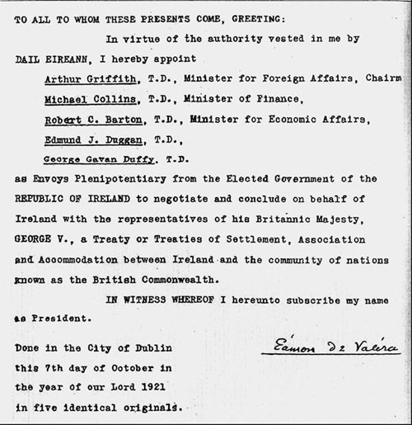

Slide 17
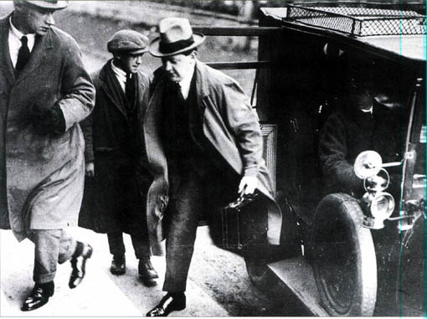
The famous first photo of Collins

Slide 18
The Peace Negotiations
On the British side of the table you have some of the most experienced negotiators in the world at that time:
  Lloyd George (Prime Minister), Neville Chamberlain (former Prime Minister), Lord Birkenhead (Chief Negotiator in WW1 peace treaty), and Winston Churchill (needs no explaining!)
  Opposite was Collins, aged just thirty years old!

Slide 19
The Peace Negotiations
Collins realised immediately that you couldn’t beat the British at the negotiation table, so he did what he did before
  He starts attending dinner parties with British High Society several times per week
  He becomes great friends with Bertrand Russell and other intellectuals of the day
  He encourages stories in the British press about romantic flings with celebrities of the day (much to the disgust of his fiancee Kitty Kiernan at home!)

Slide 20
The Peace Negotiations
Through these he creates a wonderful PR image of himself in the British public mind
  This he uses with great effect during the negotiations
He also still has his spy network working, so he knows what the British are thinking
As a result, the British negotiators found him very challenging indeed ...

Slide 21
The Peace Negotiations
Later, Lord Birkenhead said of Collins that Chamberlain, Churchill and himself were astounded at the learning of this man, - of his knowledge of economics, of his planning for the future of his country, of the winning of the every concession, some minute, that he could get in the negotiations.
The Treaty was signed on 6th December 1921 as Birkenhead was leaving the Chamber he said “Well Collins, I signed my political death warrant”.
“That’s nothing” Michael replied, “I’ve just signed my actual death warrant”.

Slide 22
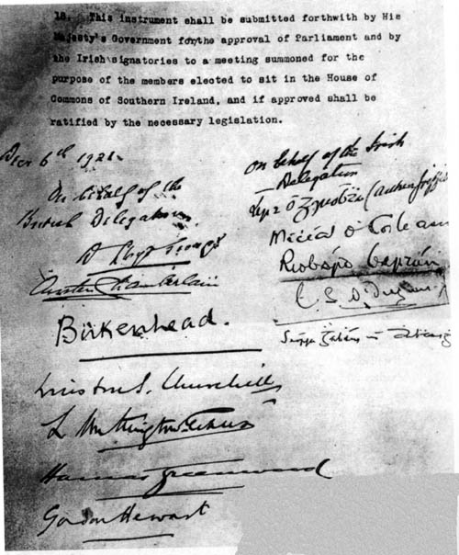

Slide 23
The Civil War
So Collins returns home with a treaty that gives Ireland independence in all but name
  i.e. Ireland had total autonomy, but still remained part of Britain and still had to swear allegiance to the King of England
The Irish parliament votes yes, so it gains legal approval
De Valera and most of the revolutionaries are appalled, so they resign from the government vowing to win full independence

Slide 24
The Civil War
The anti-treaty people occupy the main government buildings and refuse to stand down
Collins waits for four months trying to negotiate a peace, but meanwhile building up a war machine
In June 1922 a general referendum was held, with the pro-treaty side winning 239,193 votes to 133,864 against
The anti-treaty side refuses to back down

Slide 25
The Civil War
So, especially because Britain forced his hand, on the 6th July 1922 he orders a full military attack against the rebels
At the start of the civil war, Collins is outnumbered two to one
However, he is a FAR better organiser than De Valera
He also brings in lots of military weapons on loan from Britain such as aircraft, tanks, armoured cars and artillery as well as experienced British officers as technical advisors
  He was able to do this because of all the networking he did during the peace treaty negotiations
  He also has lots more money than the opposition

Slide 26
The Civil War
Collins uses a mixture of decapitation, full military engagement, propaganda and terrorism to devastating effect killing thousands of the top men of the opposition
In just one month he captures all the major Irish towns except for those in the west, especially West Cork
Coming from the same part of Cork himself, he tries a personal intervention in his home town to avoid more bloodshed in August 1922

Slide 27
The Civil War
As he travelled towards his home town in Cork, his party was ambushed on the 22nd August 1922. He was killed.
Without Collins to hold them back, the civil war turned nasty
Both sides started murdering the families of the leaders of the other side plus many more atrocities and crimes against humanity

Slide 28
The Civil War
Also without Collins’ superior organisational skills, the Civil War took a lot longer
By March 1923 De Valera realised the war was lost, but the anti-treaty side ignored his pleas
By May 1923 all the main leaders of the anti-treaty side had been killed. This allowed De Valera to reassert control and end the war

Slide 29
After the Civil War
The total damage to infrastructure was vast: £3m in 1923 (£5.8 billion today)
Also the war cost £17m (£3.3 billion today)
The two sides of the civil war turned into the two main political parties of today:
  Collins (pro-treaty) = Fine Gael
  De Valera (anti-treaty) = Fine Fail

Slide 30
After the Civil War
Both political parties are liberal conservative which is unusual in Europe
Both parties are also very similar (also unusual)
The main difference is that Fine Fail believes in giving the people what they want (populist) whereas Fine Gael believes in giving the people what is better for them (paternalist)
Both are pro-business, though Fine Gael has much more support from businessmen and the rich. Fine Fail has more support from the poor and civil servants

Slide 31
My contact details
Probably you guys should join my network on LinkedIn
  LinkedIn is a social network for business people
  It is particularly useful for business networking
  This way we can help each other in future job or business contracts
You can find me at http://www.linkedin.com/in/nialldouglas

Slide 32
My contact details
My personal website is at http://www.nedprod.com/
My business website is at http://www.nedproductions.biz/
My facebook is at http://www.facebook.com/nialldouglas
And my email is at niall@nedprod.com
Do get in contact if you think I can help or advise on something (or just to catch up!)

Slide 33
Goodbye!
Otherwise, best of luck in all your futures!
It has been an honour and a privilege to teach you!
You’re all very intelligent and I am absolutely sure you all will have very bright futures!
Thank you for having me, and goodbye!

