Slide 1
Week 11: The European Union
Wednesday 6th April
Mr. Niall Douglas

Slide 2
Schedule for Today
9am-10am: Reading and vocab check
10am-11am: The history of the European Union
11.20am-12.20pm: TOIEC
12.20pm-12.40pm: Business vocab
12.40pm-1.20pm: Group Task check

Slide 3
Reading and vocab check
Greek Cheese ...

Slide 4
The History of the European Union
Treaty of Paris (1951) creates European Coal and Steel Community
  Creates “The High Authority” (now called the European Commission)
  Creates “The Common Assembly” (now called the European Parliament)
Treaty of Rome (1957) creates European Economic Community (EEC) and European Atomic Energy Community (Euratom)

Slide 5
The History of the European Union
Merger Treaty (1965) unifies the previously established bits under “The European Community” (EC)
In 1973 Denmark, Ireland and the United Kingdom join up under the first enlargement
In 1979 the European Parliament holds its first direct election

Slide 6
The History of the European Union
In 1981 Greece joined despite being a basket case even then – a decision which plenty of people said at the time would come to haunt us later (and it did)
In 1985 the Schengen Treaty was signed established a common customs and immigration area (only Ireland and the UK have since stayed out)
In 1986 Spain and Portugal joined.

Slide 7
The History of the European Union
Also in 1986 the Single European Act was signed giving the European Community lots of extra powers.
In 1992 the Maastricht Treaty was signed which created the European Union (EU) we know today
In 1994 Austria, Sweden and Finland joined up. Interestingly, Norway, Iceland and Liechtenstein decided to partially join up to just the Single Market and Schengen area alone while staying outside the rest

Slide 8
The History of the European Union
Also in 1994 the Euro currency was created though no notes were printed. It was a “virtual” currency
In 1999 the German Bundesbank was (for all intents and purposes) renamed to the European Central Bank
In 2002 Euro notes and coins began to be circulated, replacing national currencies

Slide 9
The History of the European Union
In 2004 lots more countries joined up: Cyprus, Czech Republic, Estonia, Hungary, Latvia, Lithuania, Malta, Poland, Slovakia and Slovenia.
In 2007 Bulgaria and Romania also joined up
Personally, I think it was stupid to let Cyprus in until it resolves its sectarian problems. Unfortunately Greece forced it to happen by threatening a veto of the 2004 enlargement.
Mark my words: Cyprus will come to bite us in the ass in the future, just like letting Greece in

Slide 10
The History of the European Union
From the late 1990s there was increasing opposition to the EU by the population – not helped by endemic fraud in the EU commission in the late 1990s
It took several attempts to get the Lisbon Treaty through – in Ireland we were made to vote a second time after voting no the first time – which finally succeeded via various trickery in 2007

Slide 11
The History of the European Union
The Lisbon Treaty adds yet more complexity to the EU by attempting to simplify the EU in which (in my opinion) it dismally failed
Most European citizens, no longer remembering the Second World War, are increasingly opposed to wider European integration

Slide 12
The History of the European Union
This process of consolidation, plateau and diversification happens fairly regularly in Europe
It almost ALWAYS oscillates between East and West, so the “locus” of Europe swings like a pendulum
The Romans (281BC-476AD) consolidated as much through new territories wanting to join as being conquered (e.g. England wanted to join but Scotland didn’t, and the Germans wanted to join only Economically)

Slide 13
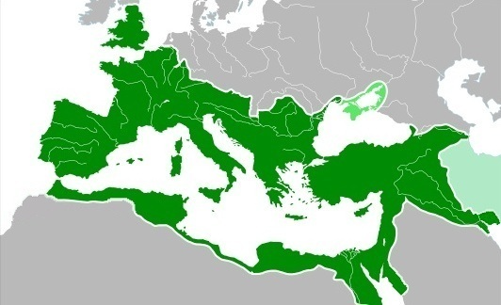
The Roman Empire in 117AD

Slide 14
The History of the European Union
As the French, German and Scandinavian peoples took over the Western Roman Empire, the centre of the Roman Empire moved eastwards from Italy to Turkey lasting until 1204AD when crusaders from those same Western countries broke the economic back of the Eastern Roman Empire
It then began to decline, being destroyed by the Muslims in 1453AD

Slide 15
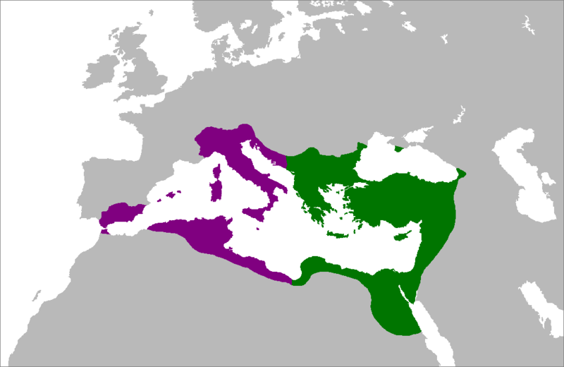
Roman Empire in 550AD

Slide 16
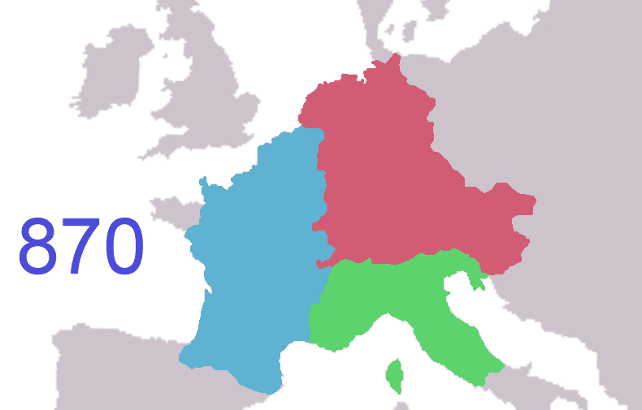
Frankish Empire in 870AD

Slide 17
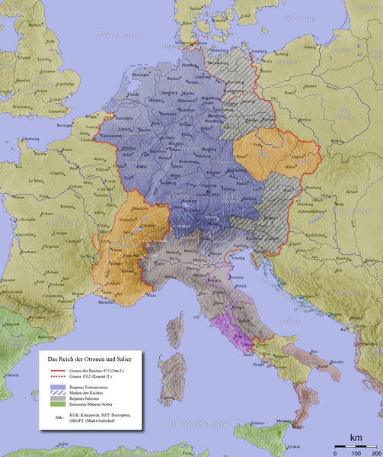
Holy Roman Empire in 1000AD

Slide 18
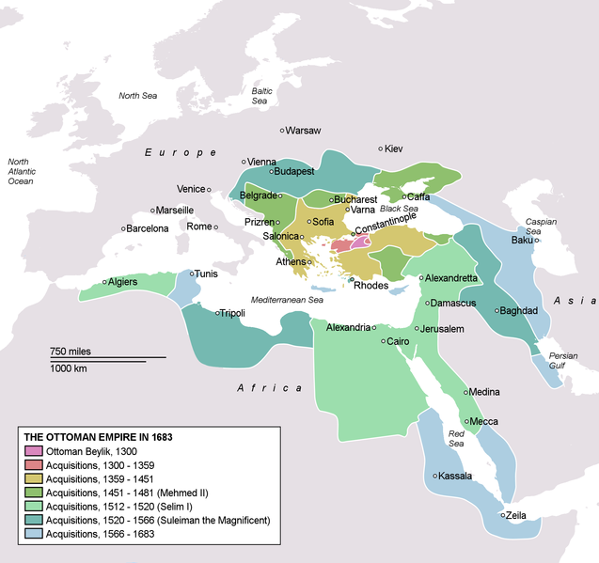
Ottoman Empire in 1683

Slide 19
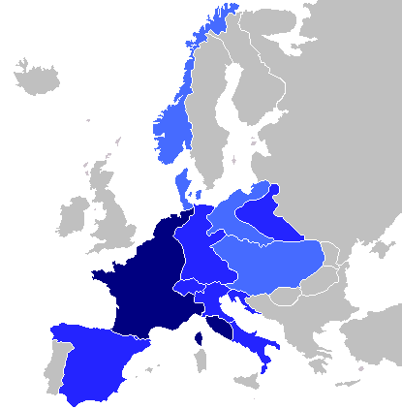
First French Empire in 1811

Slide 20
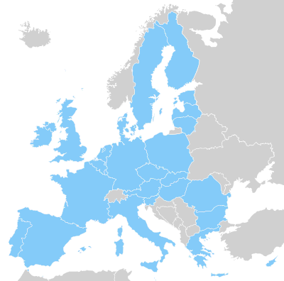
European Union Today

Slide 21
TOEIC practice
Got another TOEIC for you ...

Slide 22
Business vocab
Will I ever get through the business vocab, who knows it’s very heavy in my bag ...

Slide 23
Tonight’s reading
Explain Tonight’s reading on Belgian troubles

Slide 24
This Week’s Group Task
Group Task Work Check

