Slide 1
Week 7: Banking and Finance
Tuesday 8th March
Mr. Niall Douglas

Slide 2
Schedule for today
9am-11am: Reading vocab and comprehension check
11.20-12pm: Statistical analysis
12pm-12.40pm: TOEIC prep
12.40pm-1pm: Explain tonight’s reading
1pm-1.20pm: Group Work Plan

Slide 3
Critical Thinking
If you remember from yesterday I told you that the Western Education System (and Business Schools) is very bad at teaching critical thinking
This is despite constant and consistent complaints from Business about the poor quality of fresh Business School graduates

Slide 4
Critical Thinking
Well they are not the only ones with problems!!!
Engineering also has a BIG problem with the low quality of Engineering and Physics graduates
Such low quality engineers costs billions of euro a year in mistakes, as well as thousands of lives lost

Slide 5
Critical Thinking
One very famous example is a failure in Critical Thinking within NASA
In 1986 the Space Shuttle Challenger exploded during take off
Why?

Slide 6
Critical Thinking
It turns out that there was a failure of critical thinking in NASA regarding the safety of the launch
What happened was that an “O-ring” failed causing the rocket to explode
Here is the graph used within NASA to show O-ring failure history ...

Slide 7
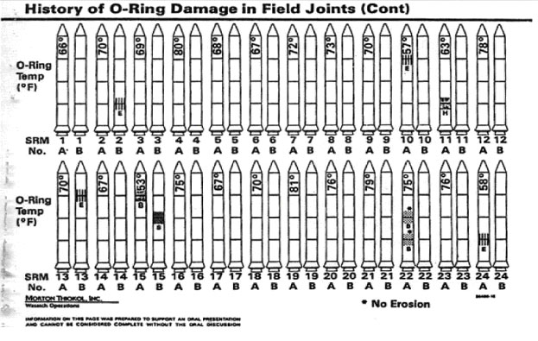
History of O-ring failure

Slide 8
Stupid graph
I have filled in the data from the stupid graph into a much more useful format

Slide 11
So there you go, lack of Critical Thinking skills blows up Space Shuttles
Six (Eight?) People died in the explosion ... Some actually survived the explosion but were killed when craft hit the sea at 200km/hr
Space Shuttles are also not cheap ...

Slide 12
TOIEC prep
TOIEC prep

Slide 13
Tonight’s reading
Explain Tonight’s reading

Slide 14
Group Task Work Plans
Check Group Task Work Plans

