Slide 1
Week 4: International Business
Tuesday 15th Feb
Mr. Niall Douglas

Slide 2
Schedule for today
9am-10am: Last night’s reading
10am-11am: Analysing Competition using Porter’s Five Forces and P.E.S.T.
11.20am-12.20pm: Practising English Presentation Skills
12.20pm-1.20pm: Tonight’s reading + Check on group work plan

Slide 3
Last night’s reading
Vocabulary check
Comprehension check

Slide 4
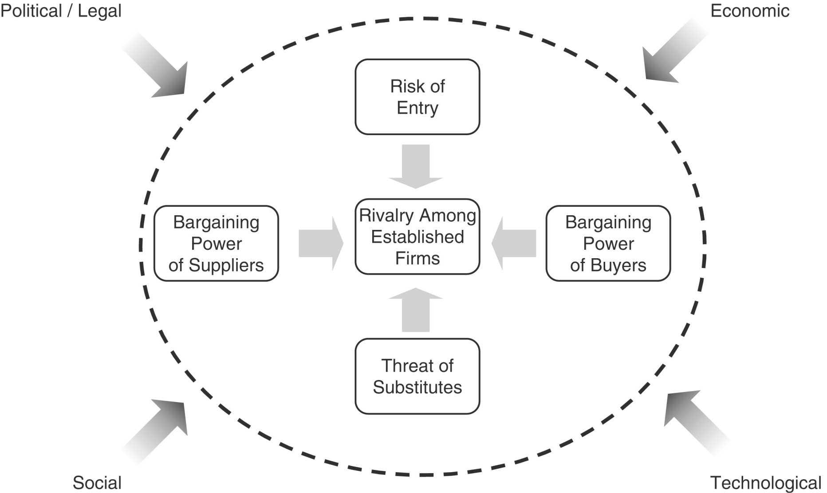
Assessment of Competition

Slide 5
Worked Example: the Apple iPhone

Slide 6
Worked Example: Germany 1

Slide 7
Introducing: Disruptive Threat to German and Chinese manufacturing
One of the biggest threats in the next few decades to German and Chinese manufacturing – and intellectual property law – is going to be 3D printing
3D printers let any small firm or even a single person convert a design on a computer into a real, fit-for-purpose object very quickly and cheaply
3D printers are coming down rapidly in cost – just €30,000 for a model which can churn out a few thousand copies
If there is going to ever be a long-term serious, perhaps fatal, threat to Germany’s Mittelstand it could be this
It will be equally threatening for the US and Britain as it makes Intellectual Property Law irrelevant

Slide 8
Worked Example: Germany 2

Slide 9
Presentation Skills
Listening 10 mins
Practice Presentation Speaking 15-20 mins
Prepare to describe graph 10 mins
20-30 mins to give mini-presentations
Total: 1 hour

Slide 10
Listening to Presentation
Listen to the track on smartphones and PDAs

Slide 11
Practice Speaking with Emphasis
Practice reading the extract about PDAs and Smartphones with your partner
Repeat with new extract

Slide 12
Write 1 min speech about graph
Prepare a 1 min speech about any one of the graphs
Make it interesting!!!
For example, flail your arms around. Become the centre of attention.

Slide 13
Give 1 min presentations
Go presentations!!!

Slide 14
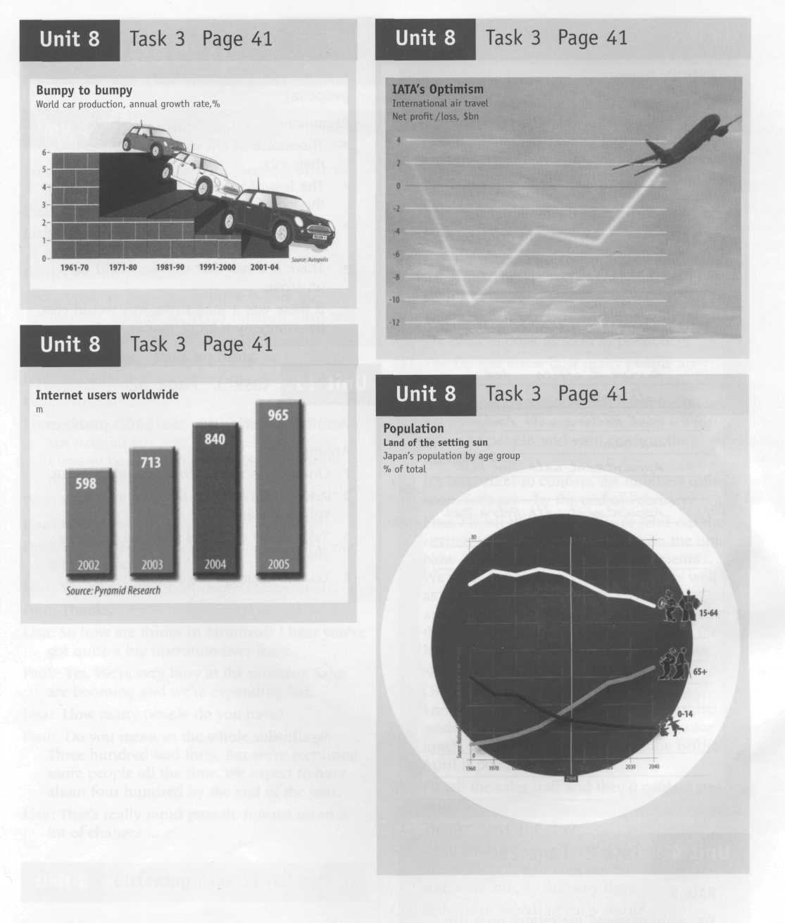

Slide 18
Reading for tonight 1/3
Well done everyone on your presentations!
Tonight’s reading is about Commodity Price Inflation
Commodity Price Inflation is going to be one of THE most important things in your future lives
What is the difference between general inflation and commodity price inflation?

Slide 19
Reading for tonight 2/3
Oil is a non-substitutable source of energy for (in priority):
  Agriculture (tractors, machines). For every “barrel” of wheat grown in the West another barrel of oil is used. It’s 10:1 for beef!
  Mining (diggers, machines – due to remoteness of most mines)
  Transport (container ships especially)

Slide 20
Reading for tonight 3/3
Currently oil is rising in price by 15-20% per year. Hence:
  Food is also rising in price by 15-20% per year
  Raw materials (copper, iron, phosphorous) are rising in price by 15-20% per year
  Transporting anything from anywhere to anywhere is rising in price by 15-20% per year
The problem is our incomes are NOT rising by 15-20% per year. So we are all going to become much poorer!!!

Slide 21
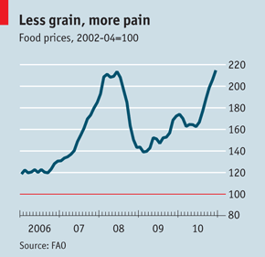
Food Price Inflation

Slide 22
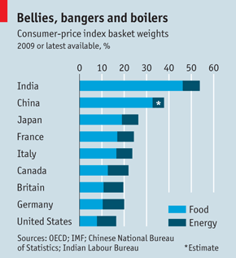
How the Indians and Chinese are more screwed than us

Slide 23
Group Task
Questions regarding Commodity Price Inflation
Break into your groups – I want to find out how your Group Task is going

